Slide 1
AfPak after 2001 PIDE, Dec 2011
Introduction
Social organization of Pakhtuns
Anomaly of special areas
Land of safe havens & warlords
FATA - a strategic space
Comparison of Pak - Afghanistan
Pak - Afghan relations
Renting space for money
Causes of Insurgency
Reasons for lack of peace
Situation in FATA today
The Paradox of the Hindu Kush Wars
Is it Genocide?
Prospects for Post 2014
Conclusions.

Slide 2
Social Organization-1
Individualist
Pukhtunwali (Nang-i-Pukhtun); Honor society
Badal
Melmastia
Nanawati
Main Constituents of Pathan Social Structure
The Jirga
Shariat
Riwaj

Slide 3
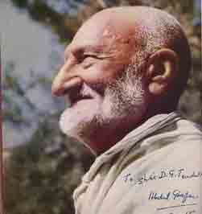
Badshah Khan

Slide 4
Ghaffar Khan’s Views of Pushtuns
“The Pathan was inclined to be violent and their violence was directed against their own kith and kin; against their closest relations. They were like smoldering embers always ready to flare up and inflict harm and injury on their own brethren.
One of their worst characteristics was their habit of revenge. They badly needed to change their anti social customs, to check their violent outbursts and to practice good behavior.” (P. 88)

Slide 5
Social Organization-2
Individuals in community
Malik
Mullah
Lashkar
Hujra
Hamsayas
Nationalism

Slide 6
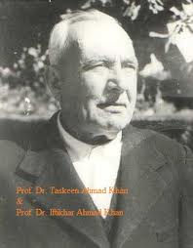
The Pathans

Slide 7
Olaf Caroe in “The Pathans”
“This fighting brought to birth a new menace, a gathering enthusiasm. There arose one of those strange and formidable insurrections among the Pathans which from time to time sweep across the frontier mountains like a forest fire, carrying all before them.
As on a previous occasion their followed a reaction, but the fire is not wholly put out. It continues to smolder dully until a fresh wind blows,” [About Hindustani Mujahideen, 1822].
(Page 300, 1954)

Slide 8
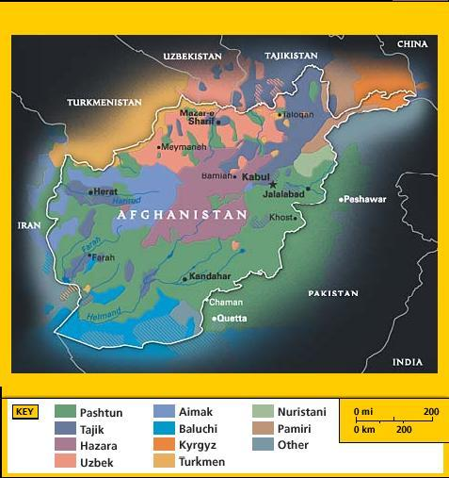

Slide 9
Anomaly of Special areas – No man’s land!
In 1901 NWFP created with connected with Tribal Areas
PART V
Treaties, Engagements and Sanads
relating to the
North West Frontier Province.
INTRODUCTION.
This tribal territory, though included in India, is not part of British India.

Slide 12
Region of Safe Havens & Warlords
Warlord dimension; historical links, Nadir Shah & Wazir – Mahsuds; safe-havens
Weak nation building; creation of narco state; weak credibility & legitimacy
“There has been more opium poppy cultivation in each of the past four years (2004–2007) than in any one year during Taliban rule.
In 2007, 92% of the non-pharmaceutical-grade opiates on the world market originated in Afghanistan. This amounts to an export value of about $4 billion.
In the seven years (1994–2000) prior to a Taliban the Afghan farmers' share of income from opium was divided among 200,000 families.
In addition Afghanistan is also the largest producer of hashish in the world.”
6

Slide 13
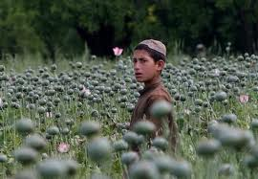
Poppies in S. Afghanistan

Slide 14
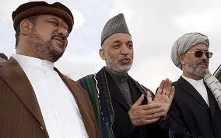
Fahim, Karzai & Khalili
Warlord with President Karzai

Slide 15
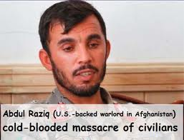

Slide 16
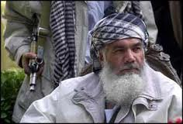
Ismail Khan, Herat

Slide 17
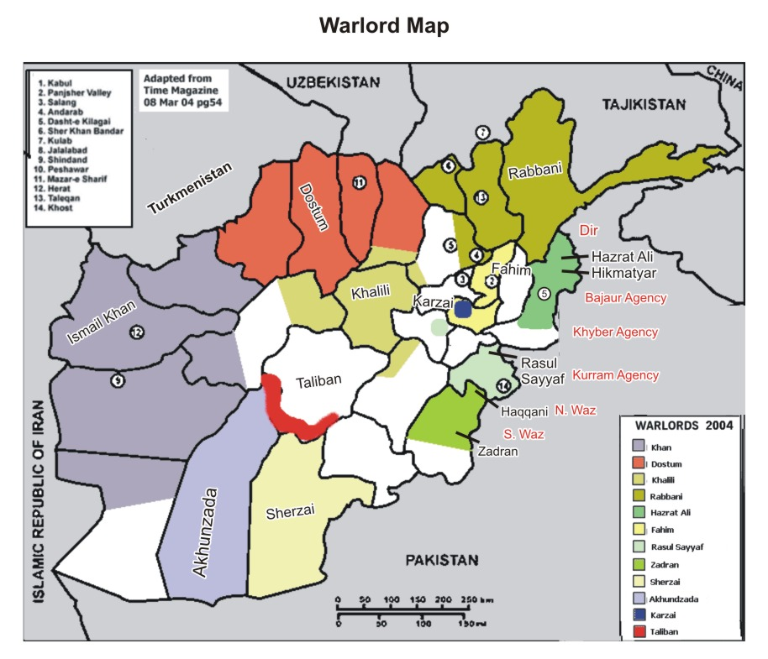

Slide 18
Warlords
No | Name of warlord |  | Afg province controlled | Area of involvement in Pakistan | Link with others & ext interference trend
1 | Hazrat Ali |  | Kunar, Dasht i Lilagai | Bajaur, Mohmand, Swat, Dir, Buner | Fahim, Rabbani, Gulbadin - Tadjikistan
2 | Rasul Sayyaf |  | Khost, Paktia, Paktika | Kurram, N. Waz, Bannu, Kohat, Hangu | Linked with al-Qaeda -Arabs
3 | J. Haqqani |  | Khost, Paktia, Paktika | Same areas | Connected with al-Qaeda - Arabs
4 | Zadran |  | Khost, Paktia, Paktika | S. Waz, N. Waz, Tank | J. Haqqani, Rasul Sayyaf
5 | Sherzai |  | Kandahar | Quetta, Zhob | Akhunzada
6 | Akhunzada |  | Helmand | Quetta, other districts in Baluchistan | Sherzai
PAKISTAN
7 |  | Gul Bahadar | North Waziristan
8 |  | Mullah Nazir | (Wazirs) South Waziristan
9 |  | Hakimullah Mahsud | South Waziristan
10 |  | Molvi Faqir | Bajaur
11 |  | Molvi Fazalullah | Swat
8

Slide 19
Hakimullah Masud

Slide 20
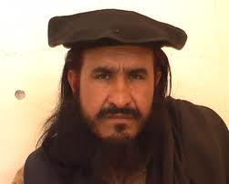
Faqir Mohammad, Bajaur

Slide 21
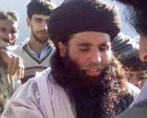
Maulvi Fazalullah, Swat

Slide 22
FATA – A Strategic Space
Pakistan conceptually contains two types of territories
Economically developed & empowered areas;
Most area East of Indus which includes Punjab & parts of Sindh
Backward & disempowered regions;
The whole of FATA with 3.5 million population
Malakand division containing 1/3rd of NWFP’s population
Districts of Tank, Lakki, Bannu & Dir / Buner
Major parts of Baluchistan.

Slide 23
Constitutional position of FATA
Indian Independence Act, Clause 7, Paragraph c:
“There lapse also any treaties or agreements in force at the date of the passing of this act between His Majesty and any powers having authority in the tribal areas, and obligation of His Majesty existing at that date to any such persons or with respect to the tribal areas, and all powers, rights, authority, or jurisdiction exercisable at that date in or in relation to the tribal areas by treaty, grant, usage, sufferance, or otherwise.”

Slide 24
Constitutional position of PATA
Art. – 247 (2) (3) (4)
(2) Executive authority of province applicable
(3) No act of provincial assembly will apply to Pata without clearance of the Governor with the approval President.
(4) The Governor with the approval of President can issue law for Pata – it has 26 members in NWFP assembly.

Slide 25
FATA Indicators
Indicators | Pakistan | NWFP | FATA
Geographical area (sq km) | 796,096 | 74,521 | 27,220
Population | 165 million | 22 million | .71 million
Literacy ratio (both sexes, %) | 43.92 | 35.41 | 17.42
Male literacy ratio (%) | 54.81 | 51.39 | 29.51
Female literacy ratio (%) | 32.02 | 18.82 | 3.00
Population per doctor | 1,226 | 4,916 | 7,670
Road (per sq km) | 0.26 | 0.13 | 0.17

Slide 26
characteristics
Under developed
Rigid social & legal structures
Poor social indicators
Minimal economic activity
Dominance of religion
Weak writ of government
Area of high militant activity
Primacy of International Politics

Slide 27
Comparison b/w Pak & Afg
Relationships of countries dictated by geography, history & national narrative
Both nations are in formative phase. Nationhood in both cases is incomplete. Afghanistan is under re-constitution for 7th time, Pakistan for 8th time.
Both are conflicted between Modernism & Traditionalism
Both ignore diversity & pluralism
No experience of Imperialism by the Afghans
Pakistan got developed structures
Both are rentier states available for strategic gaming to major powers in return for money
Thus both in grip of external powers

Slide 28
History of Pak – Afghan Relations (1)
1945 – Afghanistan recommends to the British to give Pathans the choice of either becoming a sovereign state or joining Afghanistan. No support by the people.
30 Oct, 1947 - Afghan votes against Pak admission into UN
17 July, 1947 - Referendum held in NWFP; overwhelming the vote for Pak (2.89 lacs Vs 2,874)
Nov, 1947 - Afghanistan demanded
Fata & NWFP should become a separate state (Pukhtunistan)
Pakistan should provide Afghanistan a special corridor for Karachi or creating a free zone.
Neutrality in case either was attacked.

Slide 29
Pak – Afghan Relations (2)
30 July 1949 - Afghan King while addressing the Assembly repudiated all treaties before the birth of Pakistan including Durand Line.
Aug, 1949 - Pro Afghan tribal Jirgas in Tirah. In Razmak they met and elected Faqir of IPI as President of Southern Afghanistan.
India supported these claims
1949 - Pak continued to give subsidies to tribes amounting to more than Rs. 50 mill this exceeded Afghan budget.
1950 - Afghan signs a trade pact with USSR *

Slide 30
Pak – Afghan Relations (3)
Feb, 1954 - US approves arms assistance to Pakistan
Dec, 1954 - US refuses Afghan request for arm assistance
Jan 1955 - Afghan accepts USSR offer of arm assistance
1957 - US provides Afghan development assistance
1960 - Afghan lashkar attacks Bajaur
1973 – 1977 – Daud begins to shift from USSR & leans towards Iran & Pakistan
1978 – 1992 – PDPA Coup & Najibullah’s rule ended Soviet presence in Afghanistan
1996 – 2001 Taliban Rule
2002 – 2014 Karzai’s rule

Slide 31
Internal structures
Both Afghanistan & Pakistan are rentier states
Definition
A state in which at least 25% of its income is derived from abroad or its income to that extent is generated by non-direct tax based on inflation / export of mineral resources.
There are 3 main means to reconstitute social order:
Taxes
Land tenure
Transportation – Communication
Potential exists in Pakistan but absent in Afghanistan

Slide 32
Rent taking in Pakistan
1947-57 Evacuee property Largest resource transfer since British land grants.
1958-68 (Ayub Khan) Rents from licensing regime import substitution, protection 271% 1963-64; Bonus Voucher “Green Revolution”, water related – regional imbalances.
1973-77 (Z.A. Bhutto) Rents from i) Nationalization ii) Lateral entries iii) Export of manpower to M.E
1977-88 (Gen Zia) i) Rents from Afghan Jihad ii) Weapons iii) Drugs
1990 (BB & NS) i) Loans ii) NIT & ICP
1999-2007 (Gen Musharraf) i) Stock market manipulation ii) WoT
Result = Concentration of wealth & reproduction of poverty.

Slide 33
Pakistani Strategic slot machine
Pakistan contains two types of territories
Economically developed & empowered areas;
Most of them lie east of Indus which includes Punjab & parts of Sindh
Gaming regions;
The whole of FATA with 3.5 million population
Malakand division containing 1/3rd of NWFP’s population
Major portion of Baluchistan.

Slide 35
Afghan Finances
Afghanistan from Amir Abdur Rehman’s time depended on external income from Britain - £ 1.87 million in 1897
Zahir Shah, US & USSR
Daud, USSR , US & Iran (1973: 80% budget from external resources)
Tarraki … Najibullah, USSR & latter inflation (80%)
Taliban….tolls, coercion & drugs
Karzai … US & Western assistance, Drugs

Slide 36
Causes of Insurgency
1973 oil price like – Privatization of State; Washington Consensus
Neo Liberalism or Neo Colonialism
Debt re-structuring
Poverty 1980 9-12%; 1990’s 20-22%
Cut in social sectors
Madressahs & Islamic charities (Afghan war)
Iranian Revolution
Social-legal reforms-Zia-ul-Haq.
Religion enters politics, Electorate pro religion 2008 elections
Impact on Afghanistan
Drugs
Arms – Steven Coll $ 66 bill of weapons pumped into region
Breakdown of traditional leadership
Warlordism
Rise in Militancy due to Taliban resistance
4

Slide 37
Situation in FATA Today
War caused by 3 factors
US invasion of Afghanistan
Arrival of Islamist elements
Poverty; Reflects elements of Naxalite typology
Kashmiri proxy fighters
Flawed Afghan battle plan Oct 2001 reliance on SFO, CIA, NA
Impact of military action in breaking traditional patterns of control in Fata
There is respite in violence
The war has shifted to urban Pakistan/Malakand/Kunar/E. Afg
5

Slide 38
The Paradox of the Hindu Kush Wars
Hidden behind the JIHAD against the SOVIETS from 1980-89, the AFGHAN CIVIL WAR 1990-96, the TALIBAN rule 1996-2001 and in the WAR against Terrorism 2001-14 is a period of 30 years of GENOCIDAL WAR against the Pakhtun – Unfortunately it will not be ending in 2014. See the following MAPS.

Slide 39
Raphael Lemkin (1944) ‘Genocide’
By 'genocide' we mean the destruction of an ethnic group . . . . Generally speaking, genocide does not necessarily mean the immediate destruction of a nation……..The objectives of such a plan would be disintegration of the political and social institutions, of culture, language, national feelings, religion, and the economic existence of national groups, and the destruction of the personal security, liberty, health, dignity, and even the lives of the individuals belonging to such groups

Slide 40
The Convention on the Prevention and Punishment of the Crime of Genocide (CPPCG) was adopted by the UN General Assembly on 9 December 1948 and came into effect on 12 January 1951
Any of the following acts committed with intent to destroy, in whole or in part, a national, ethnical, racial or religious group, as such: killing members of the group; causing serious bodily or mental harm to members of the group; deliberately inflicting on the group conditions of life, calculated to bring about its physical destruction in whole or in part; imposing measures intended to prevent births within the group; [and] forcibly transferring children of the group to another group.

Slide 41
1947

Slide 42
Soviet War

Slide 44
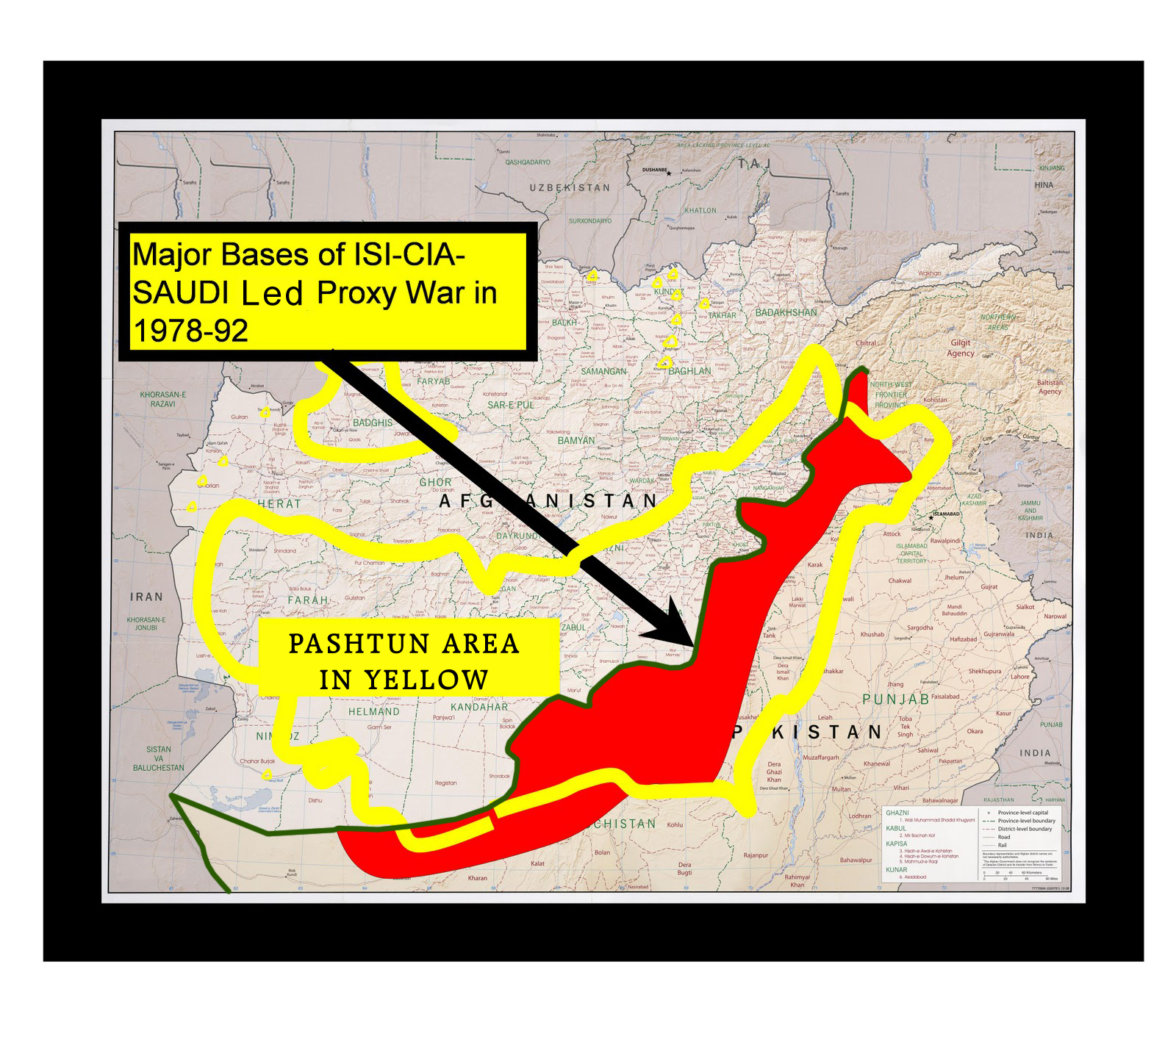

Slide 45
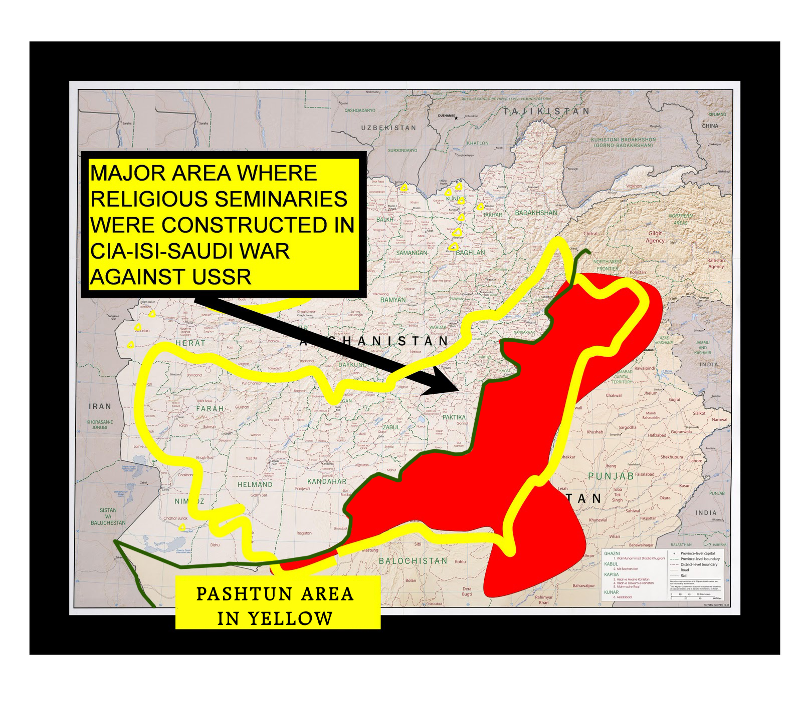

Slide 46
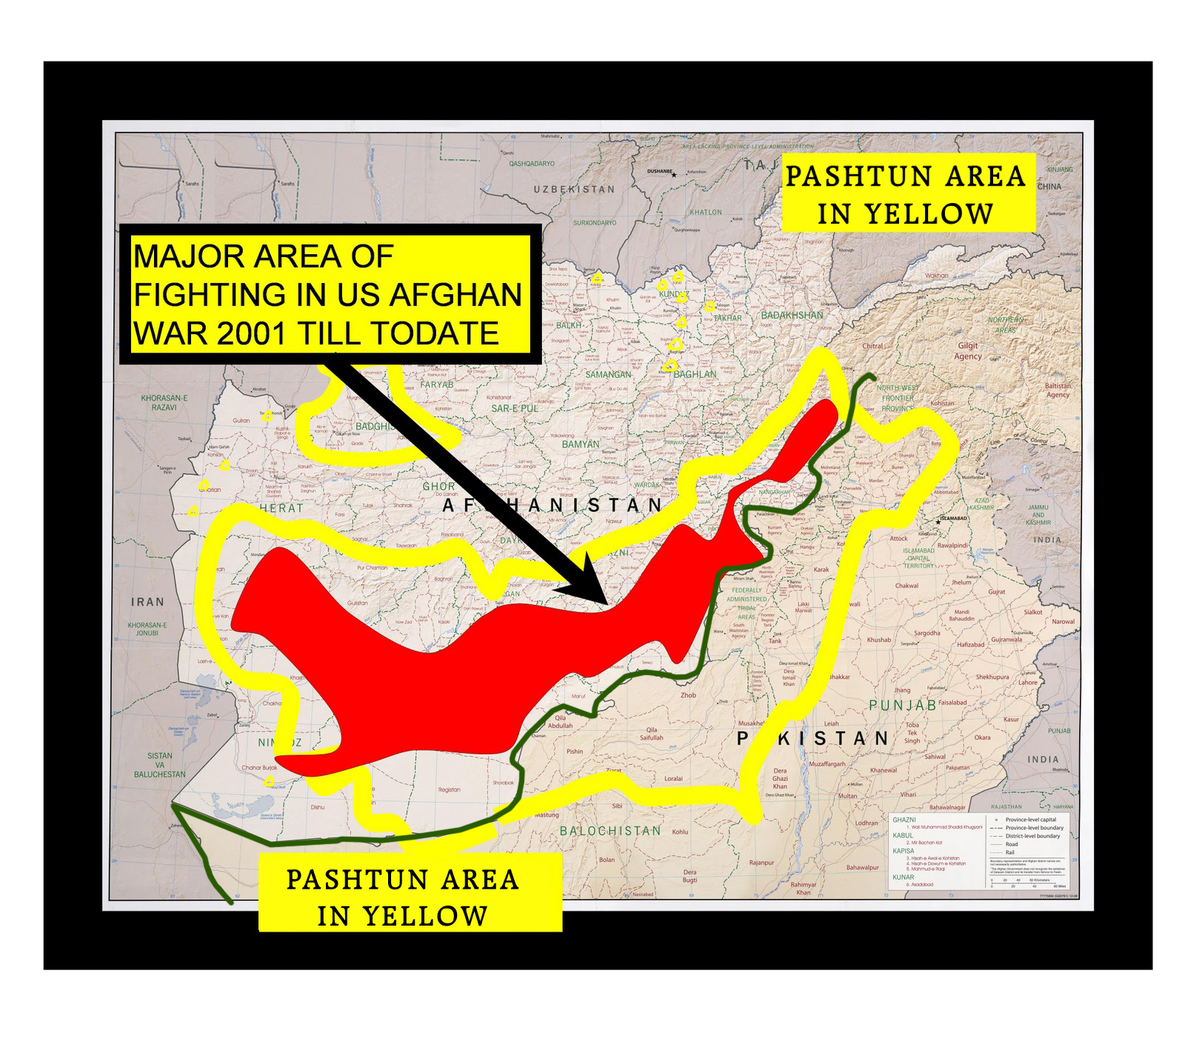

Slide 47
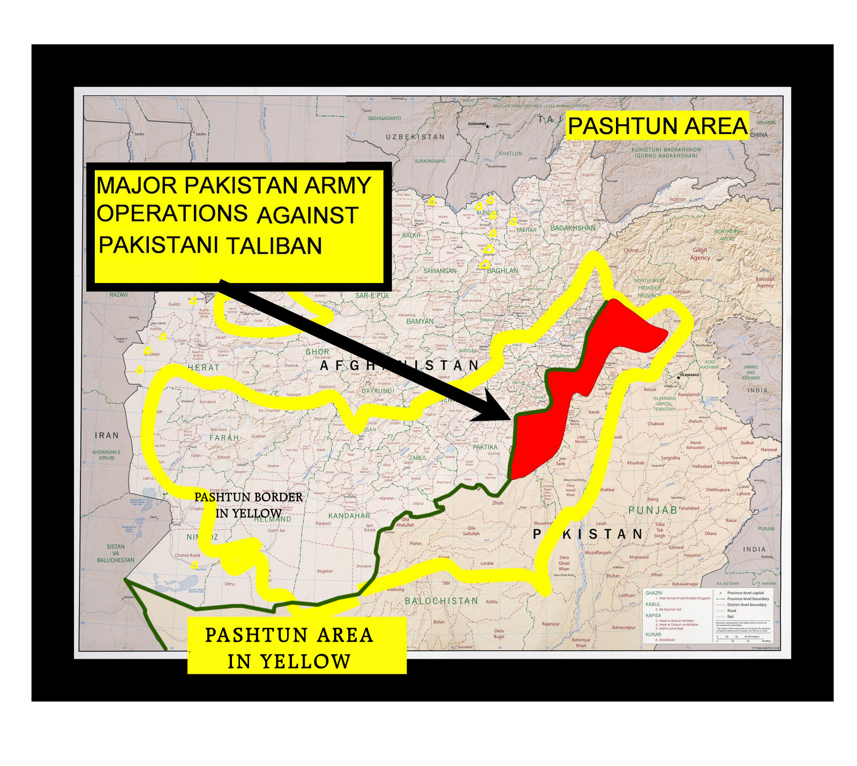
2005

Slide 48
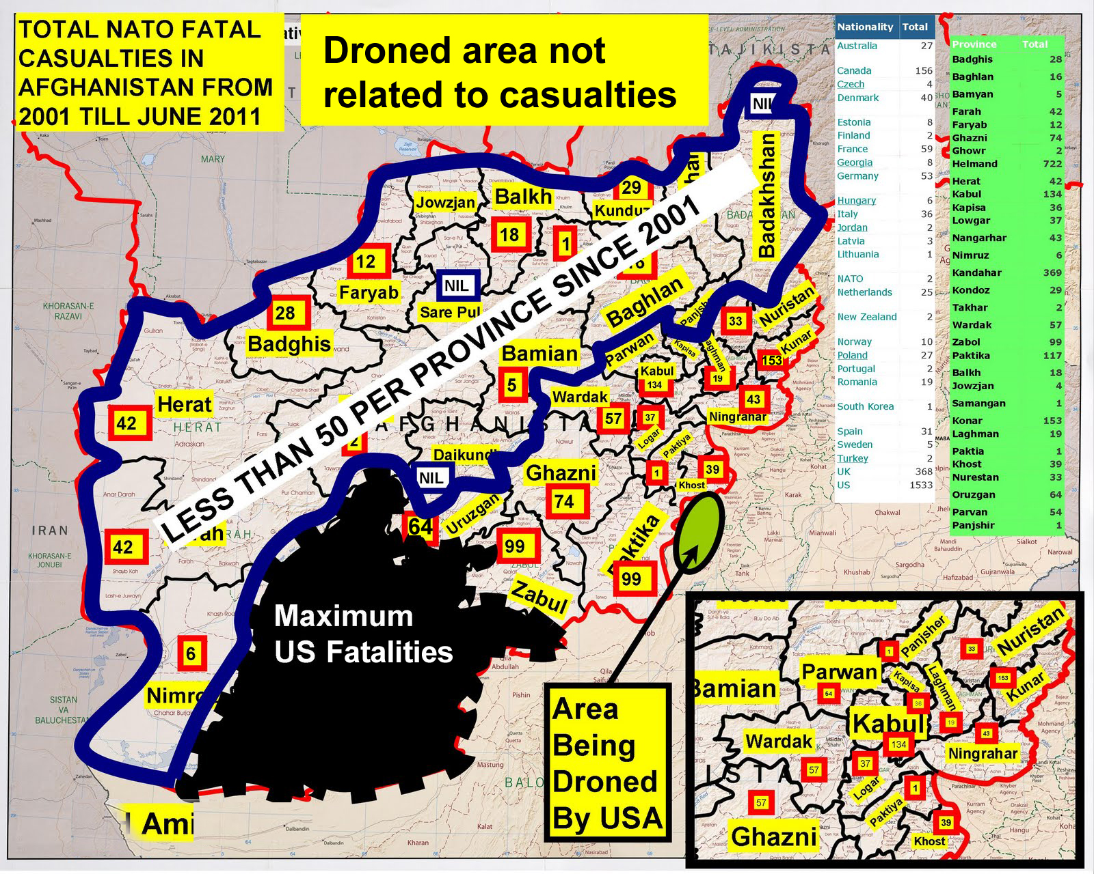

Slide 49
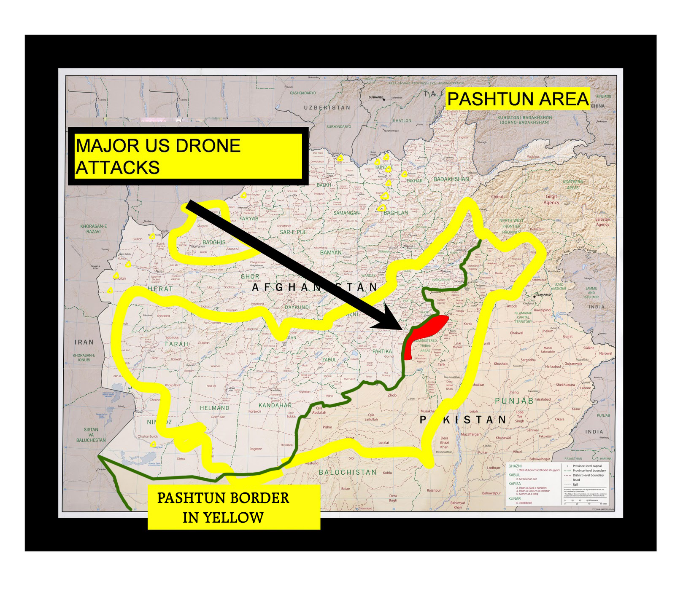

Slide 50
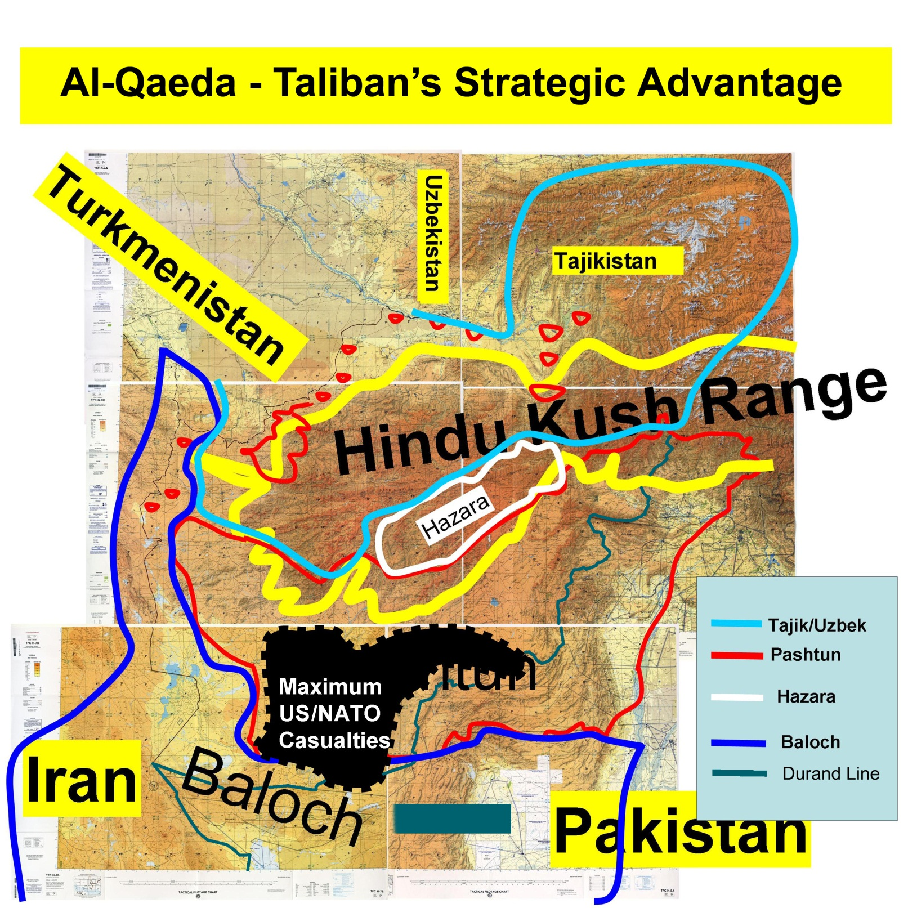

Slide 51
Main reasons for lack of peace
Demographic pressure – The queue is broken
Poor Governance
War due to flawed foreign policy in Afghanistan / Kashmir
Precedence of belief over economics
Rentier economies
Poverty
Unemployment except in violence industry
Weaponization
Drugs
Lack of empowerment

Slide 52
Prospects Post-2012

Slide 53
Predictions
Relations between US & Pakistan will get worse leading to skirmishes; Pakistan will be blamed in US elections for failure in Afghanistan. US & India will get closer.
It will create tense civil-military relations in Pakistan
Afghanistan will become more insecure
International financial crisis will worsen evaporating any hope of funding for Afghan security. ANA & ANP need $ 7-9 billion a year.
The Chicago Conference will not succeed – nations will want to leave Afg.
US will retain forces beyond 2014 – SFO & Drone attacks will increase on Pakistan
A new set of security & foreign policy based on trade, openness and peace can transform the paradigm

Slide 56
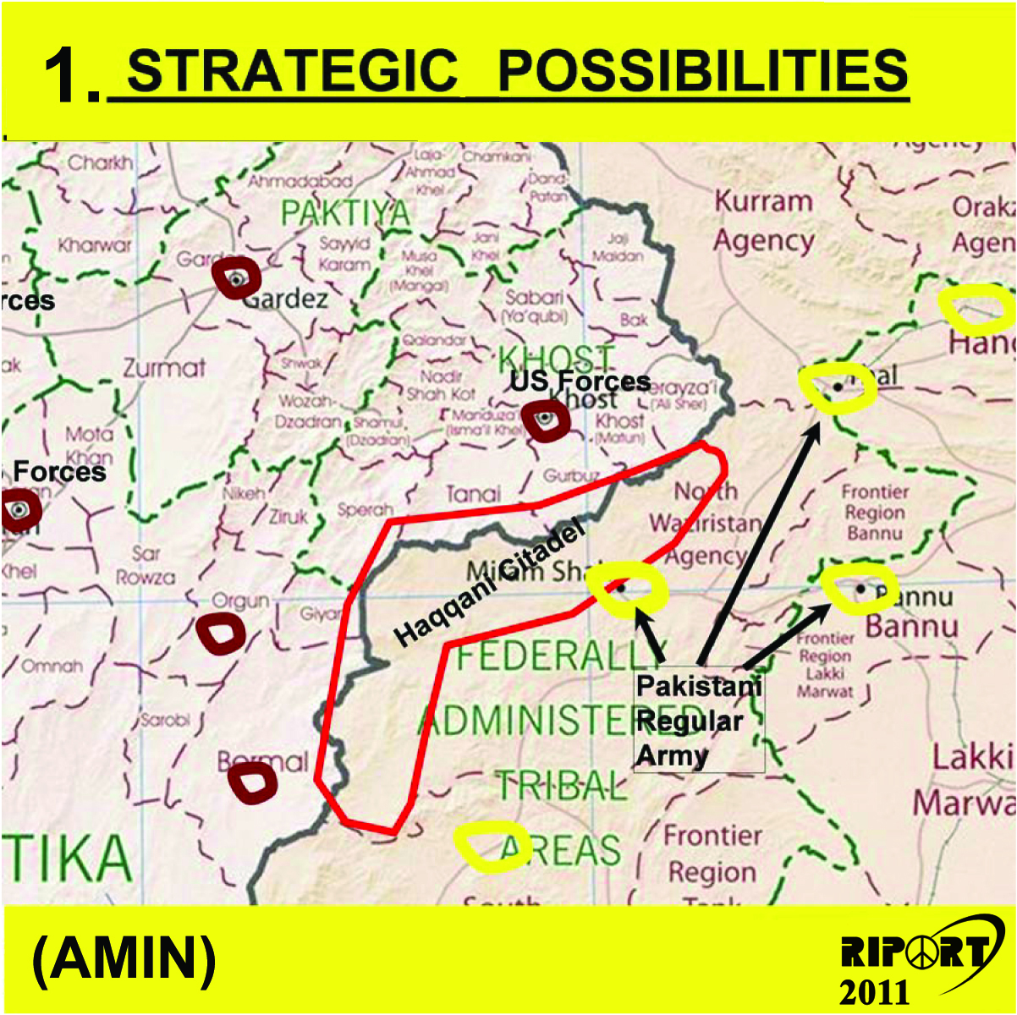

Slide 57
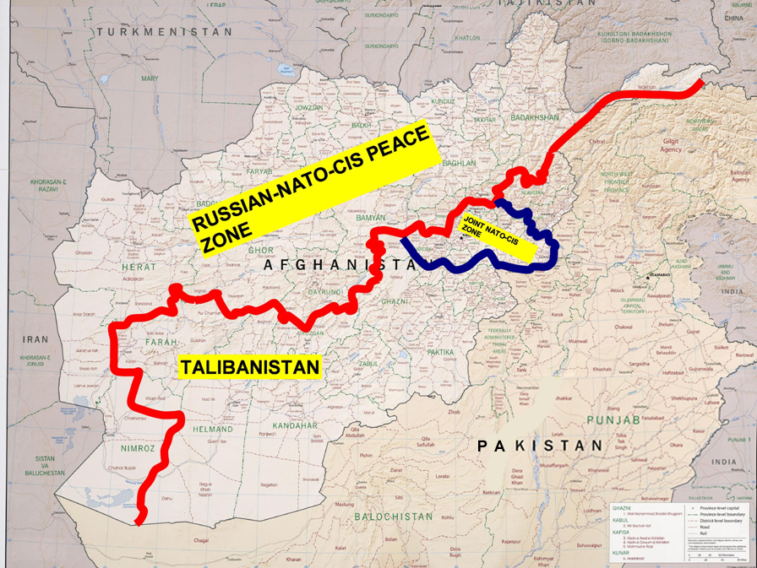
Proj – 1

Slide 58
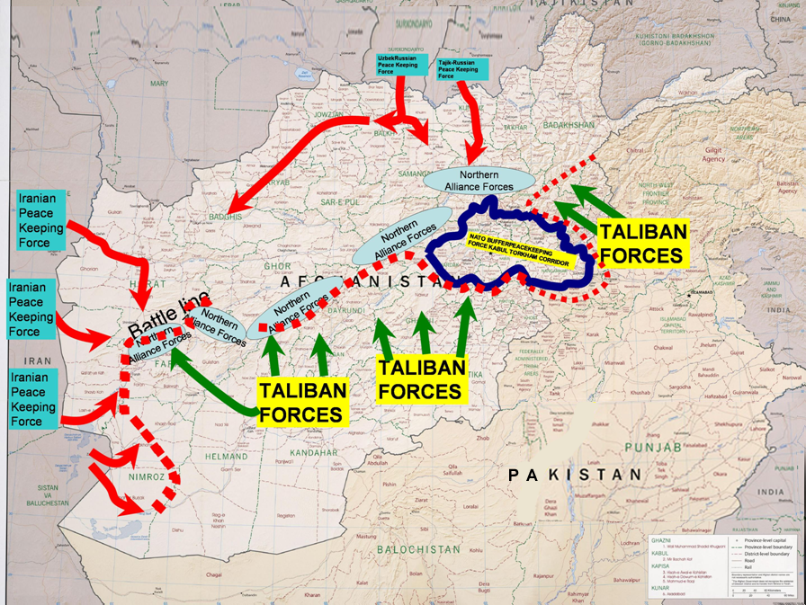
Proj – 2

Slide 59
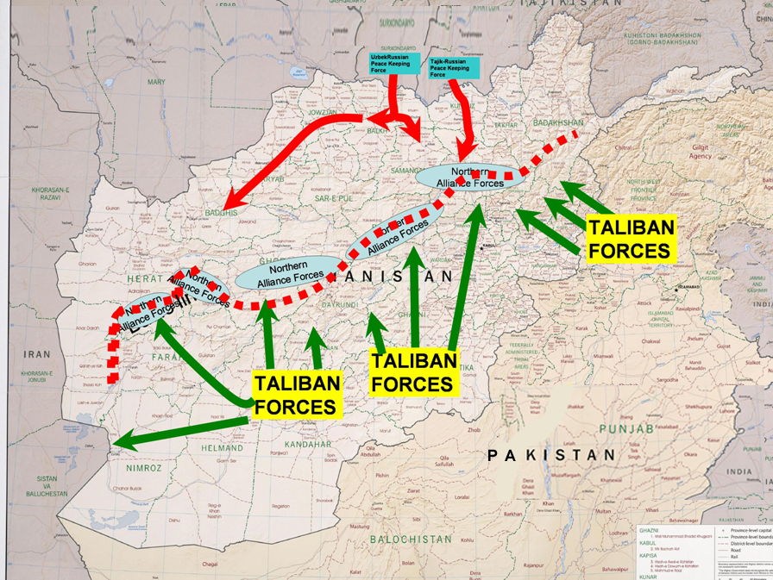
Proj – 3

Slide 60
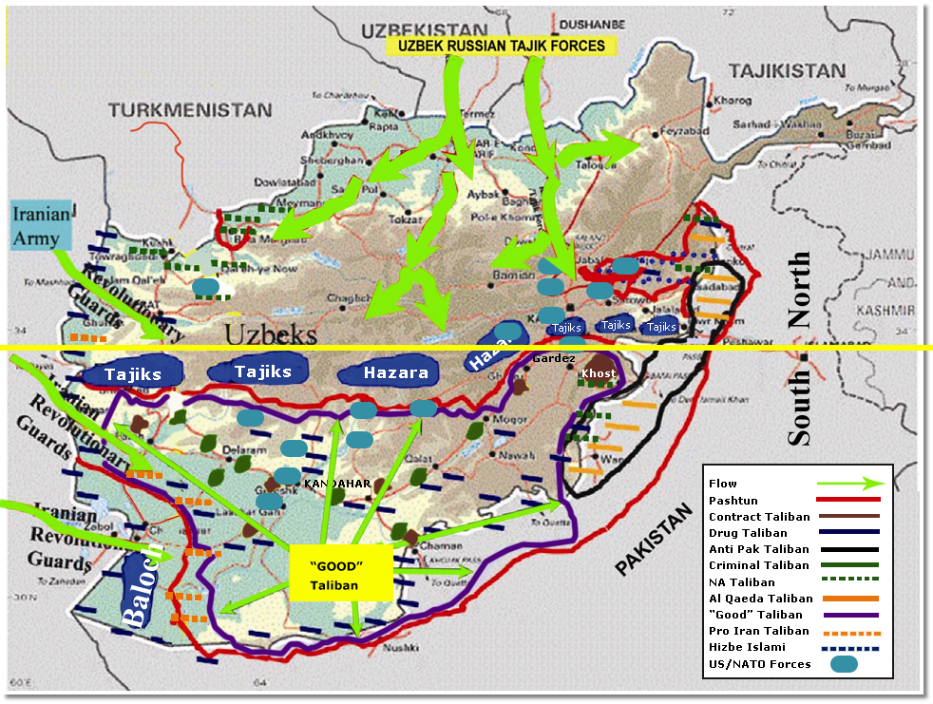
Post 2014

Slide 61
Conclusions
The geography, culture and strategic location of Pakistan & Afghanistan will invite intervention
Formal war may end but a long duration CT war will replace it
Both Afghanistan & Pakistan will remain troubled and tortured nations for the foreseeable future
The US is likely to remain in the area with a military presence
Regional pressures & resources will draw in other countries into the wars post 2014.

Slide 62
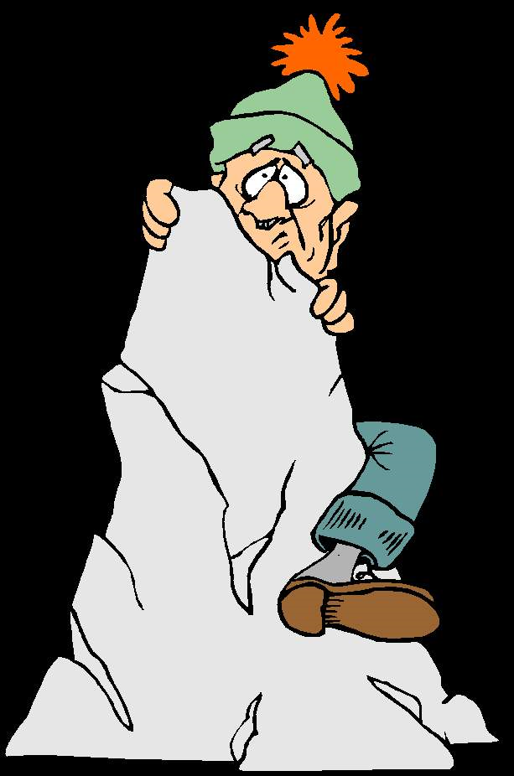
Clinging to Hope

